Slide 1
Kickstarter Performance Dashboard
Group Members
Ritesh Gaikwad
Ashmika K.V
Sakshi Ghanshyam Gandhi
Gaurav Chanduji Acharya
Jitendra Goswami
Anirudh S

Slide 2
Index
SR.NO | SLIDES
1 | Introduction
2 | Data Source & Tools
3 | KPI Analysis
4 | Dashboard Overview
5 | SQL Implementation
6 | Conclusion & Suggestions
7 | Challenges & Learnings

Slide 3
Introduction
Objective:
Analyze Kickstarter crowdfunding projects.
Identify project success trends.
Understand funding and backer behavior.
Tool Used:
MySQL → Data storage & querying
Power BI → Dashboard
Tableau → Visualization
Excel → Data cleaning & Transformation

Slide 4



Key Performance Indicator Slides
KPI 1: Total Amount Raised
Insight: Overall funding achieved.
Observation: Successfully funded projects raised approximately $3.5 Billion.
KPI 2: Total Backers
Insight: Community participation.
Observation: Successful projects attracted around 40 Million Backers.
KPI 3: Average Successful Days
Insight: Average campaign duration.
Observation: Successful projects ran for approximately 32 Days.

Slide 5
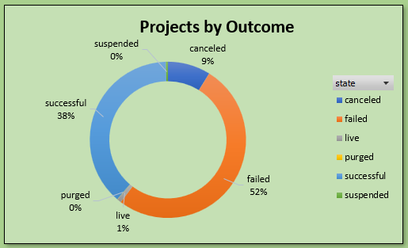

KPI
KPI 4: Project Success Rate
Insight: Overall platform performance.
Observation: About 38.3% of projects were successful.
KPI 5: Projects by Outcome
Insight: Distribution of project statuses.
Observation: Failed projects dominate, followed by successful projects.

Slide 6
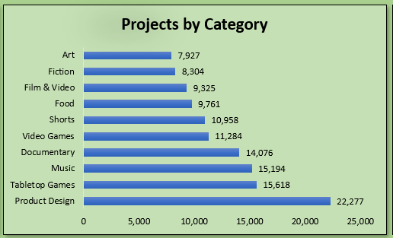
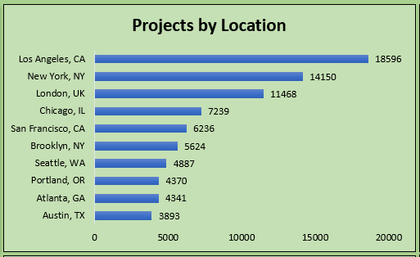
KPI
KPI 6: Projects by Category
Insight: Most popular categories.
Observation: Product Design, Tabletop Games, and Music have the highest number of projects.
KPI 7: Projects by Location
Insight: Geographic concentration.
Observation: Los Angeles, New York, and London lead in project creation.

Slide 7
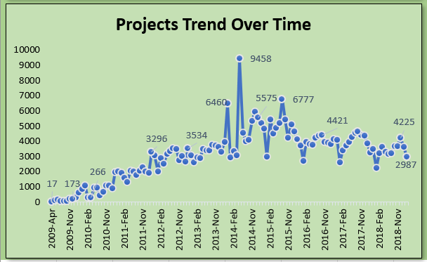
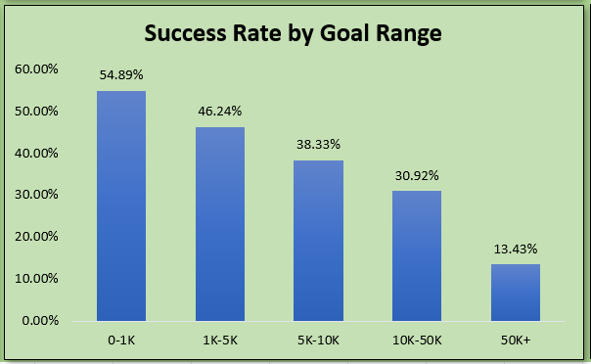
KPI
KPI 8: Projects Trend Over Time
Insight: Growth pattern.
Observation: Strong growth until 2014–2015 followed by stabilization.
KPI 9: Success Rate by Goal Range
Insight: Funding target impact.
Observation: Lower funding goals have significantly higher success rates.

Slide 8
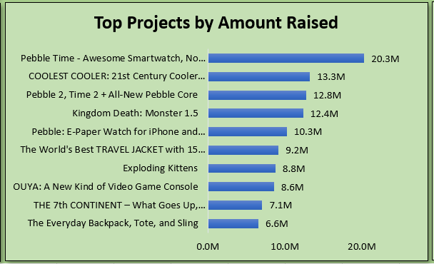
KPI
KPI 10: Top Projects Analysis
Insight: Highest-performing campaigns.
Observation: Projects such as Exploding Kittens and Pebble Time achieved exceptional funding and backer support.

Slide 9
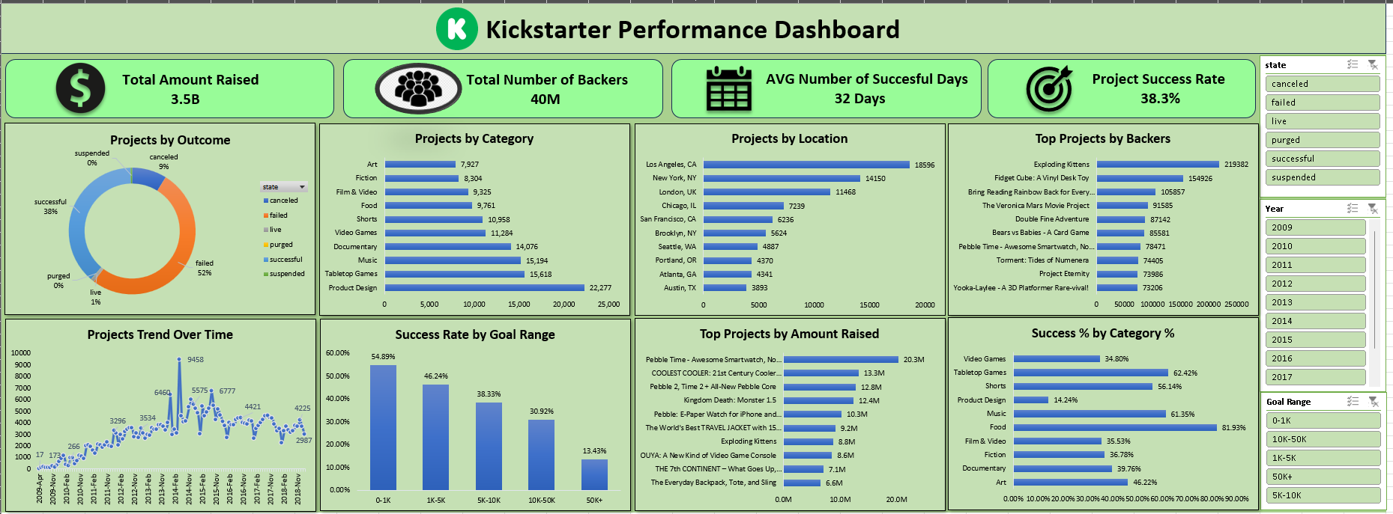
Dashboard Overview

Slide 10
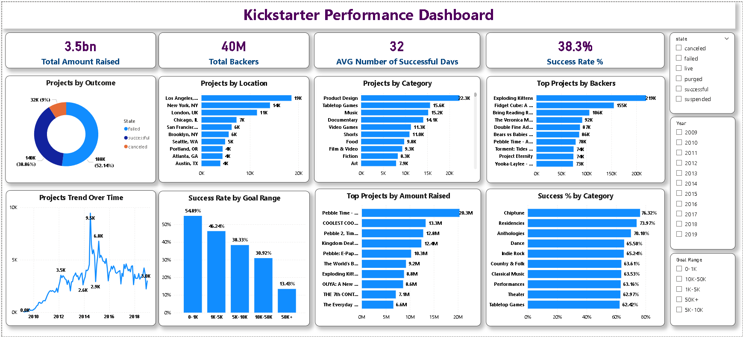
Dashboard Overview

Slide 11
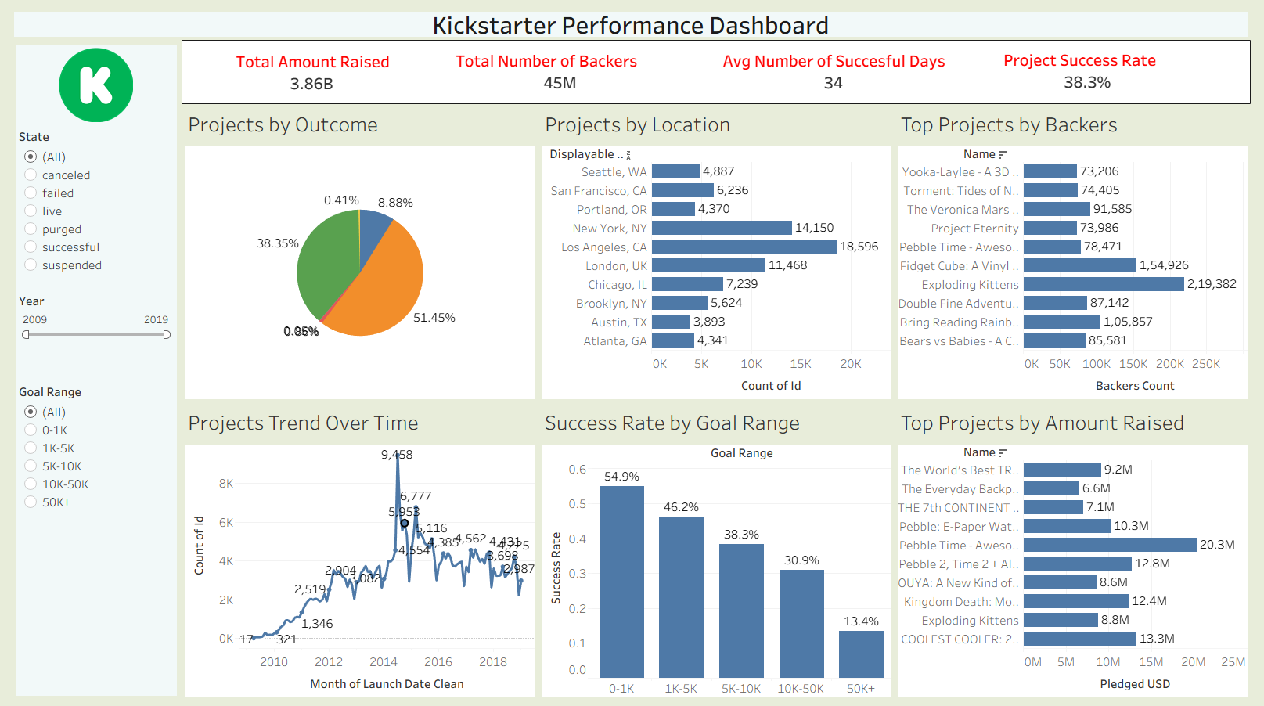
Dashboard Overview

Slide 12
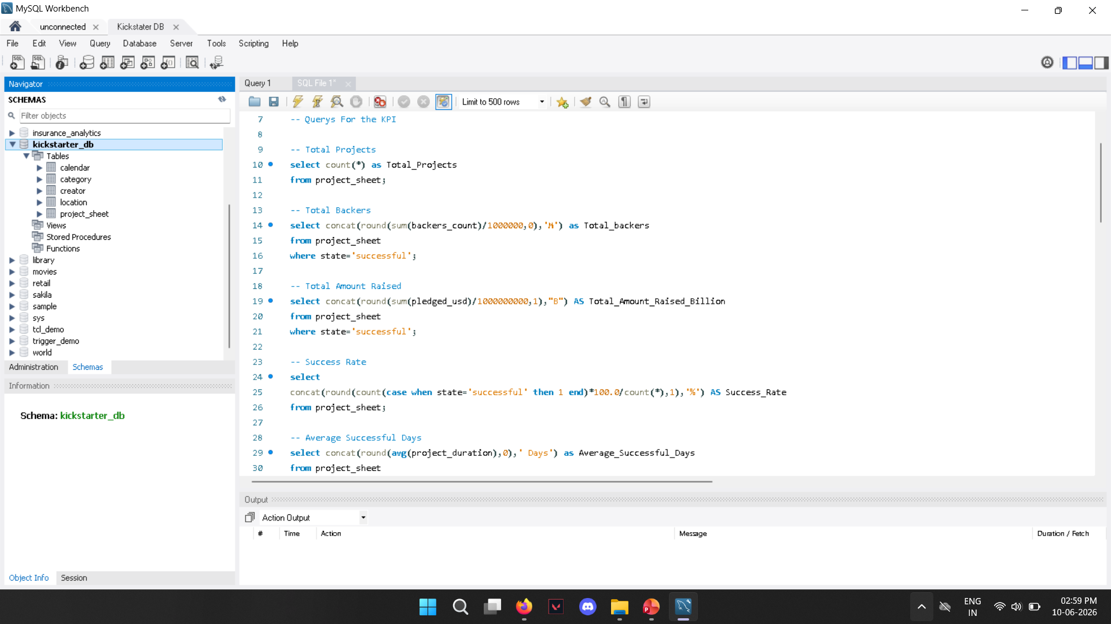
SQL Implementation

Slide 13
Conclusion & Suggestions
Conclusion
Kickstarter generated significant funding.
Product Design is the leading category.
Large cities dominate project creation.
Lower funding goals show better success rates.
Suggestions
Encourage realistic funding goals.
Promote projects in emerging locations.
Focus on categories with high success rates.
Improve visibility for new creators.

Slide 14
Challenges & Learnings
Challenges
Data cleaning and formatting.
Date conversion in SQL.
Location table mapping issues.
Dashboard formatting in Tableau and Power BI.
Learnings
Dashboard development.
KPI analysis and storytelling.
End-to-end data analytics workflow.
SQL joins and aggregations.

